Slide 1

Designing an 8:1 Analog Multiplexer
EEE 466- Analog Integrated Circuit Laboratory
Jan 2023 Leve-4 Term-2
Final Project Demonstration
Submitted by – Group G2-07
Md Ayenul Azim
1806089
Shahriar Khan
1806092
Saif Ahmed Sunny
1806097
Shahriar Ahmed
1806192

Slide 2
Outline
Abstract
Introduction
Design
Analysis and Evaluation
References

Slide 3
1. Abstract
1.Abstract
1. Circuit Design: Designing pmos,nmos and their interconnections required to construct the 8-to-1 multiplexer circuit.
2. Component Selection: Choosing appropriate analog mos from “tsmc18” library such as nmos3v,pmos3v, voltage sources, ground(analoglib) to implement the designed circuit.
3.Simulation: Using simulation software (cadence virtuoso) to verify the functionality of the designed circuit and ensure that it performs as expected under different input conditions.
4. Analysis and Performance Evaluation: Analyzing the multiplexer's performance in terms of bandwidth, charge injection, input capacitance , on resistance etc

Slide 4
2. Introduction
2.Introduction
Multiplexer (MUX) is a fundamental circuit used for data selection and routing. It allows one of several input data signals to be chosen and directed to a single output based on control signals.
Transmission Gates: Transmission gates, also known as pass gates or analog switches, are used as a key component in multiplexers to efficiently switch between input signals.
Key Concept: The core concept of a multiplexer using transmission gates involves using complementary transmission gate pairs controlled by the same set of control signals to selectively route input signals.

Slide 5
3.1 Design: Methods
3.1 Design: Methods
The Design Process includes the following steps
selector block : The selector block converts 3V and -3V bias supply to 1.4V and 0V for the selectro pin logic high and low.
Transmission gate : Transmission gate is designed to implement pass transistor logic.
2:1 Multiplexer : 2:1 multiplexer is designed as a builsing block.
8:1 Multiplexer : Finally, 8:1 multiplexer is designed by interconnection of 7 2:1 multiplexers.

Slide 6
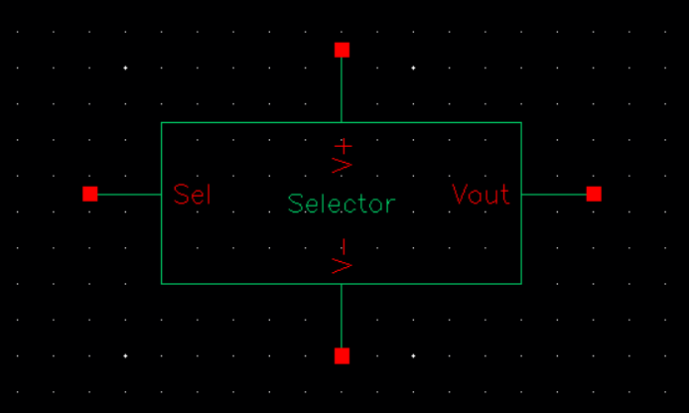
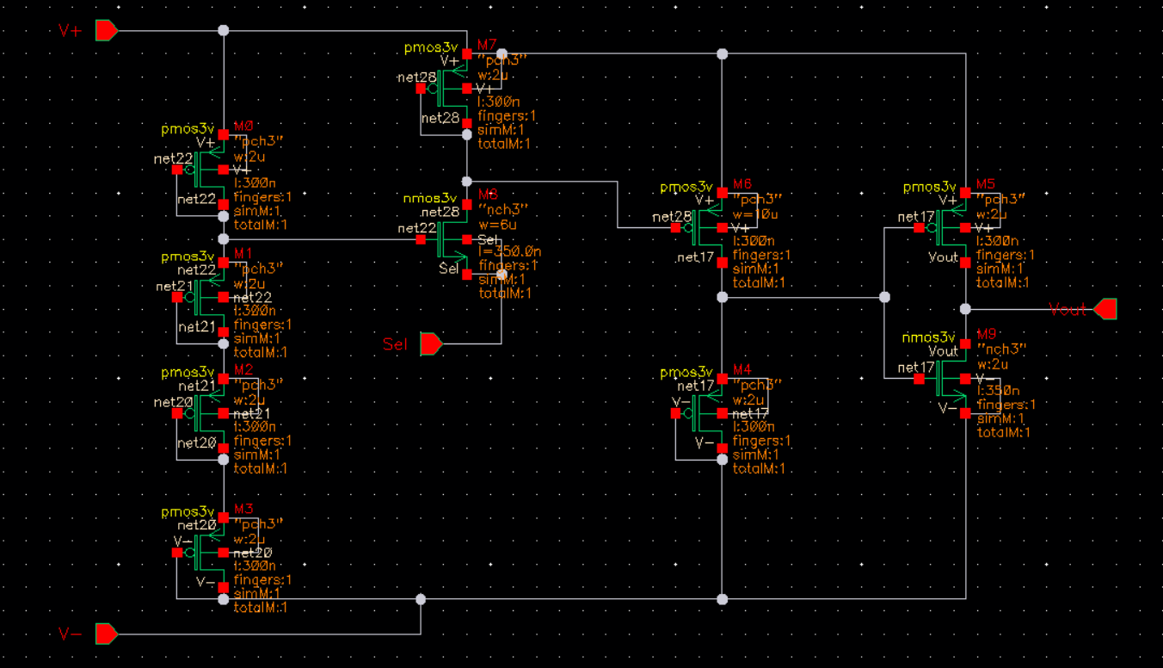
3.2 Design: Circuit Diagram
3.2 Design: Circuit Diagram
The selector block

Slide 7
3.2 Design: Circuit Diagram
3.2 Design: Circuit Diagram
The selector block

Slide 8
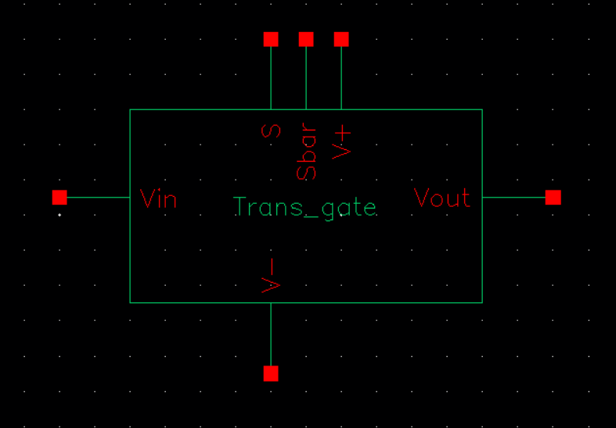
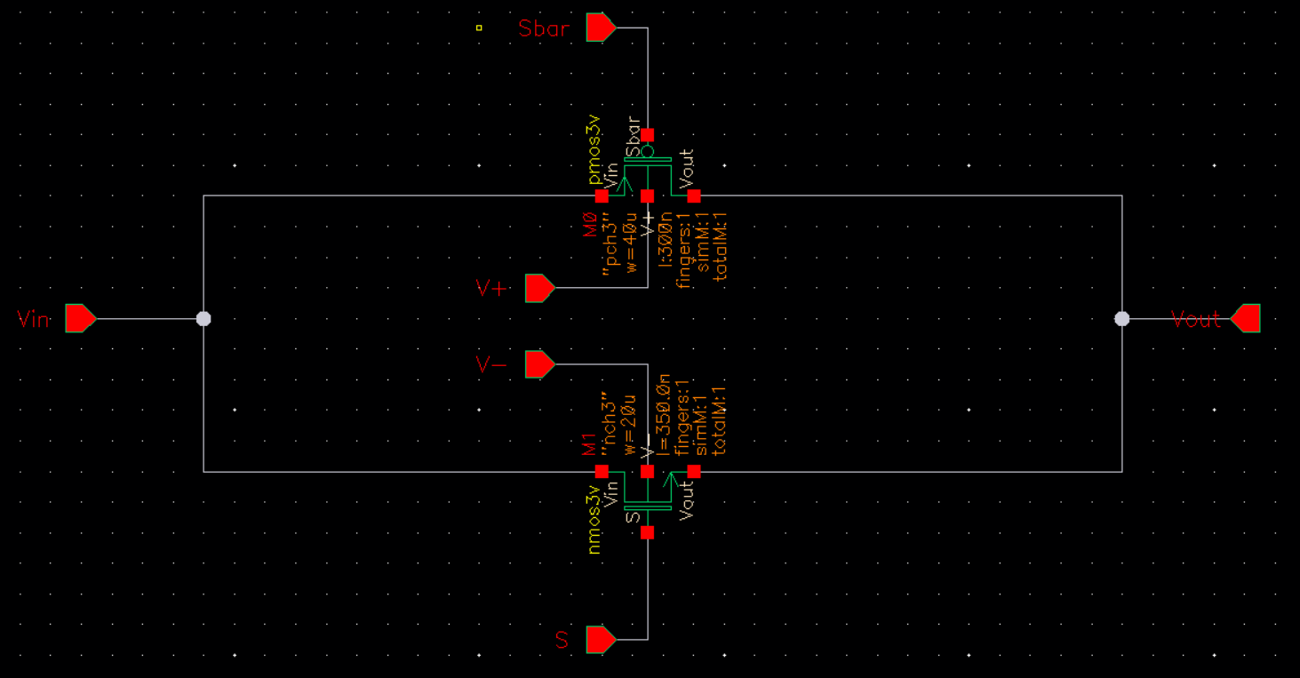
3.2 Design: Circuit Diagram
3.2 Design: Circuit Diagram
Transmission Gate

Slide 9
3.2 Design: Circuit Diagram
3.2 Design: Circuit Diagram
Transmission Gate

Slide 10
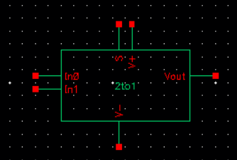
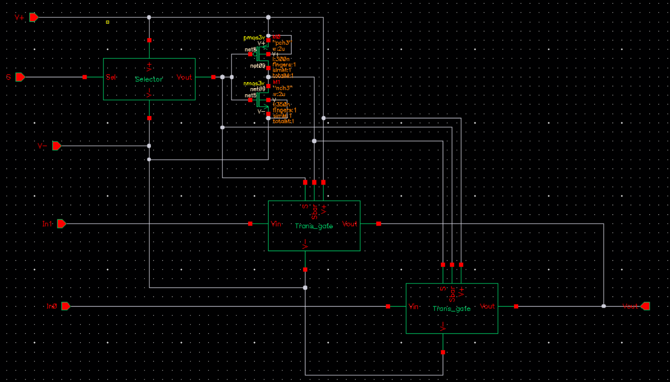
3.2 Design: Circuit Diagram
3.2 Design: Circuit Diagram
2:1 Multiplexer

Slide 11
3.2 Design: Circuit Diagram
3.2 Design: Circuit Diagram
2:1 Multiplexer

Slide 12
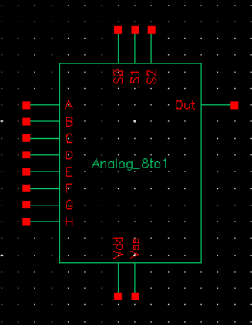
3.2 Design: Circuit Diagram
3.2 Design: Circuit Diagram
8:1 Multiplexer (The Final Circuit)

Slide 13
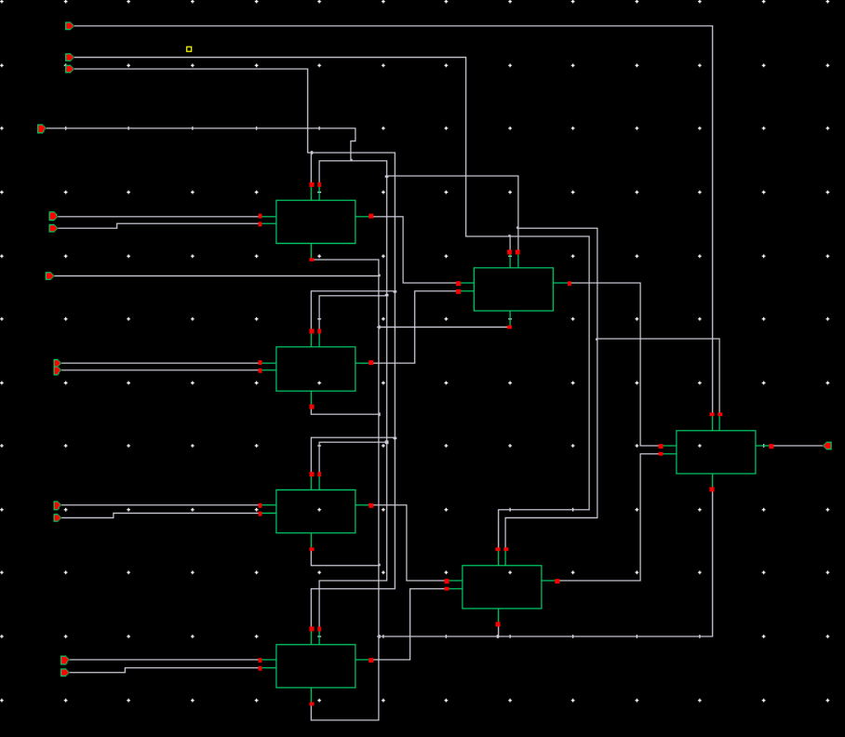
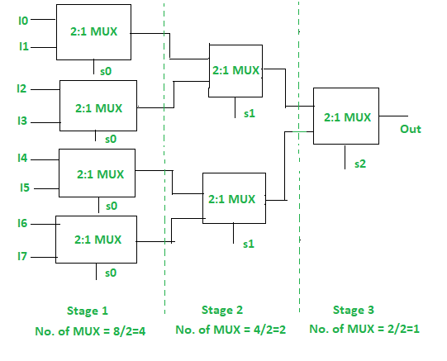
3.2 Design: Circuit Diagram
3.2 Design: Circuit Diagram
8:1 Multiplexer (The Final Circuit)

Slide 14
4. Analysis and Evaluation
4. Analysis and Evaluation
4.1 Output based on selector pins
4.2 Specifications

Slide 15
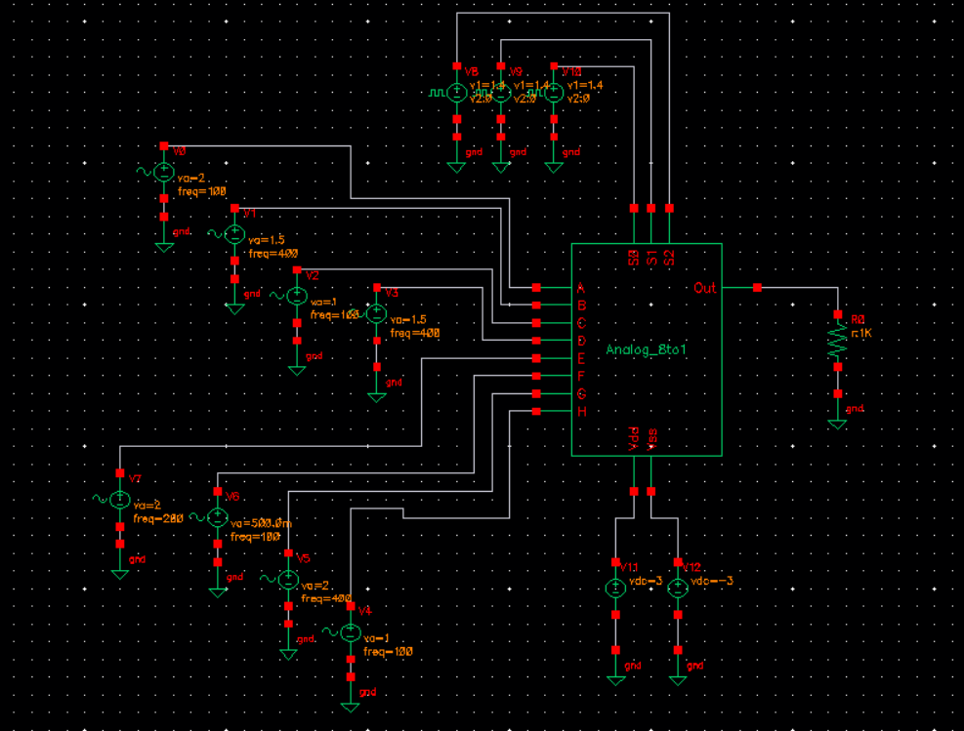
4.1 Output based on selector pins
4.1 Output Based on Selector Pins
Circuit Setup

Slide 16
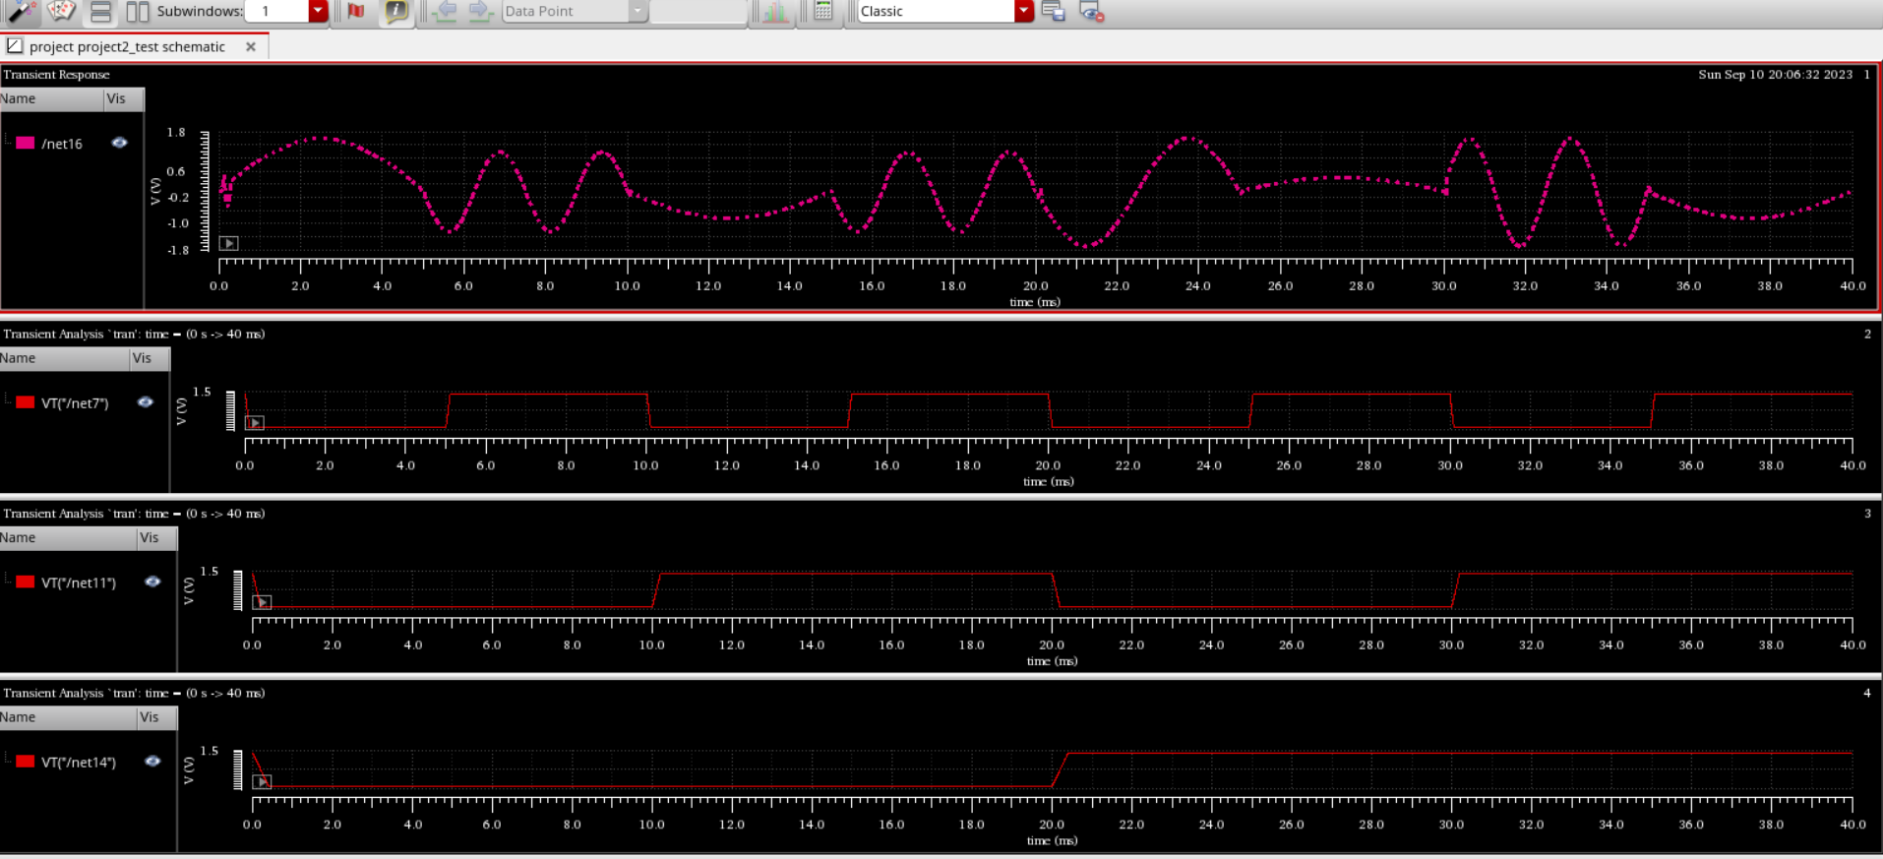
4.1 Output based on selector pins
4.1 Output Based on Selector Pins
Output Plot

Slide 17
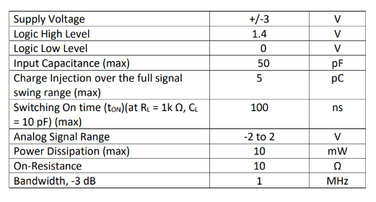
4.2 Specifications
4.2 Specifications
Given Specifications to be met

Slide 18
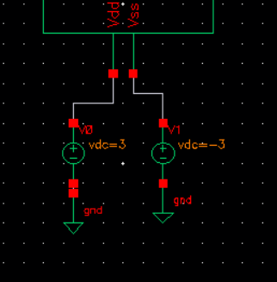
4.2 Specifications
4.2 Specifications
1. Supply Voltage (Required +/-3 V)
We have biased the circuit with Vdd = 3V and Vss = -3V. So, This specification is met.

Slide 19
4.2 Specifications
4.2 Specifications
2. Logic High Level (Required 1.4V)
By the “Selector Block”, logic level high and low (1.4V and 0V) is converted to +/-3V. This voltage is used to bias the circuit to get the required signal swing
3. Logic Low Level (Required 0V)
By the “Selector Block”, logic level high and low (1.4V and 0V) is converted to +/-3V. This voltage is used to bias the circuit to get the required signal swing
So, 1.4V is logic high and 0V is logic low. This specification is met.

Slide 20
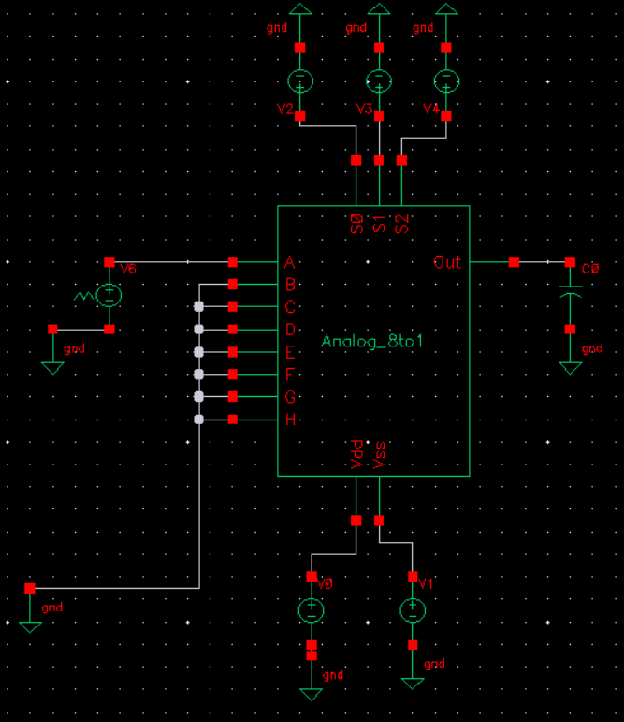
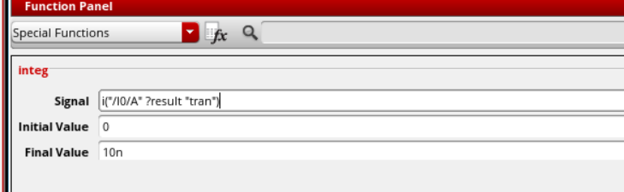
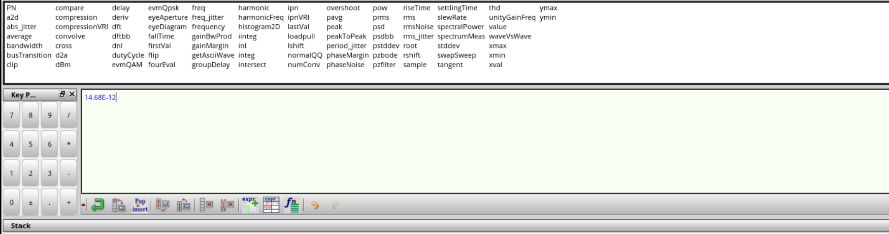
4.2 Specifications
4.2 Specifications
4. Input Capacitance (Required 50pF max)
Circuit Setup
Result

Slide 21
4.2 Specifications
4.2 Specifications
4. Input Capacitance (Required 50pF max)
Input capacitance is found 14.68 pF < 50pF
This specification is met
5. Charge injection over the full signal swing range (Required 5pC max)
Not calculated

Slide 22
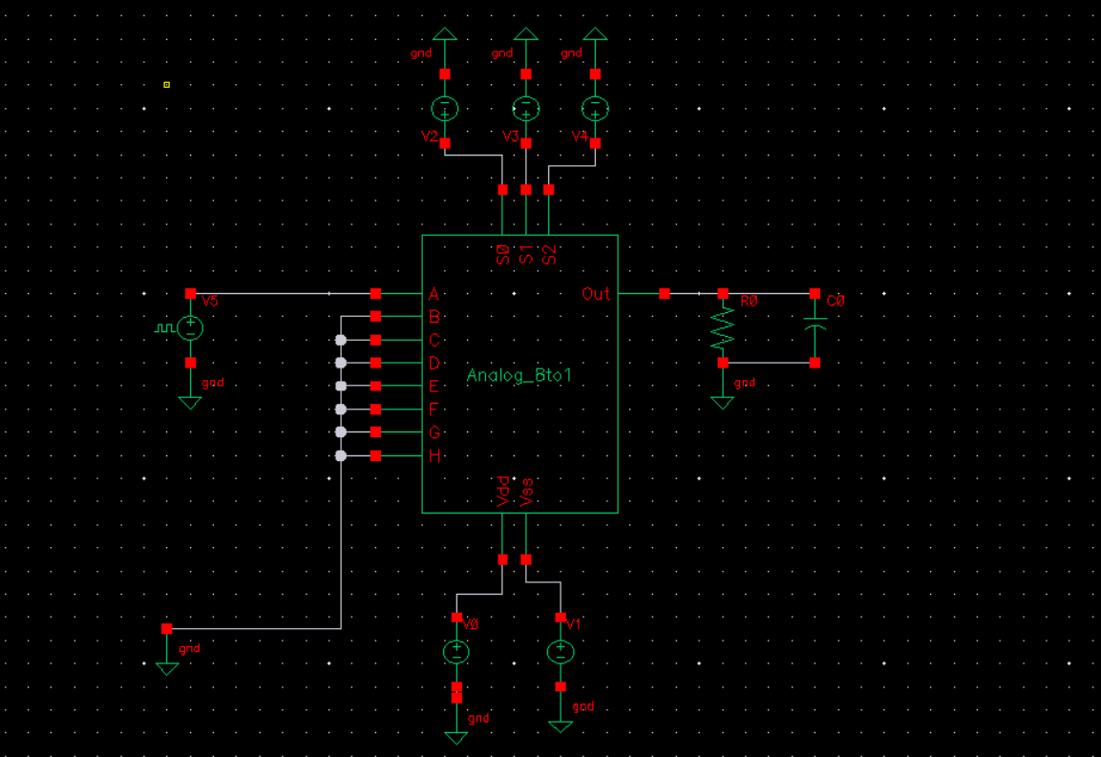
4.2 Specifications
4.2 Specifications
6. Switching on time (t_{ON}) at R_{L} = 1k and C_{L} = 10pF (Required 100ns max)
Circuit Setup

Slide 23
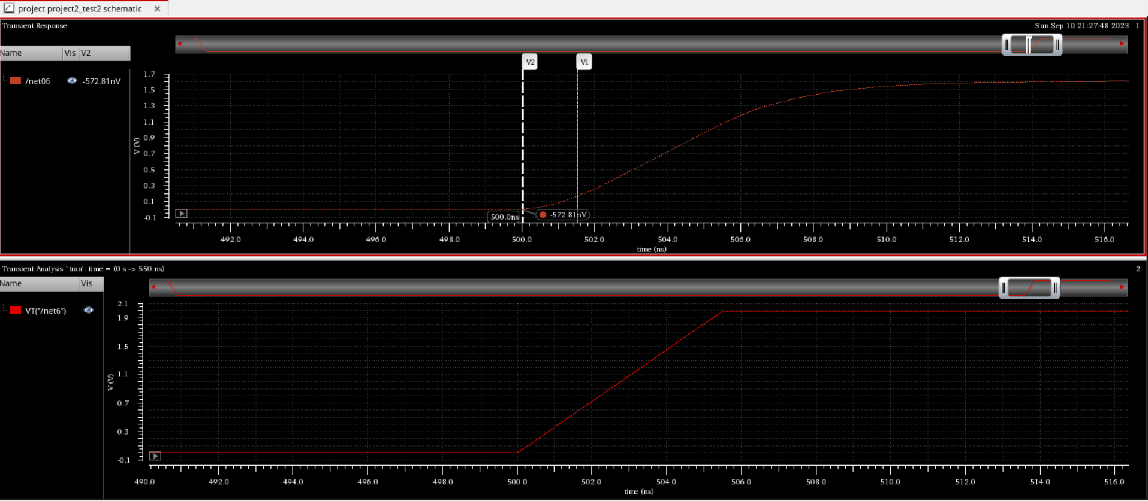
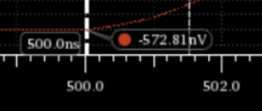
4.2 Specifications
4.2 Specifications
6. Switching on time (t_{ON}) at R_{L} = 1k and C_{L} = 10pF (Required 100ns max)
Output
t_{ON} is found around 2ns < 100ns.
This specification is met

Slide 24
4.2 Specifications
4.2 Specifications
7. Analog Signal Range (Required -2V to +2V)
We have tested the circuit by giving sinusoidal input with amplitude 2V peak and the circuit works. The output follows the input but is a little attnuated due to loss in circuit.

Slide 25
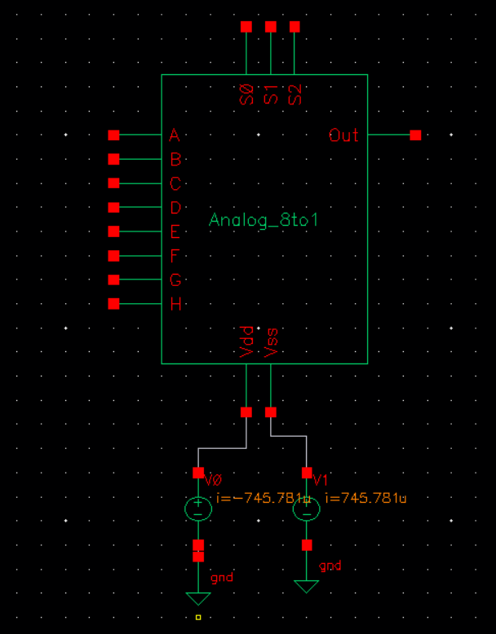
4.2 Specifications
4.2 Specifications
8. Power Dissipation (Required 10mW max)
Power dissipation =
V_{dd}*I_{dd} + V_{ss}*I_{ss} =
4.47 mW

Slide 26
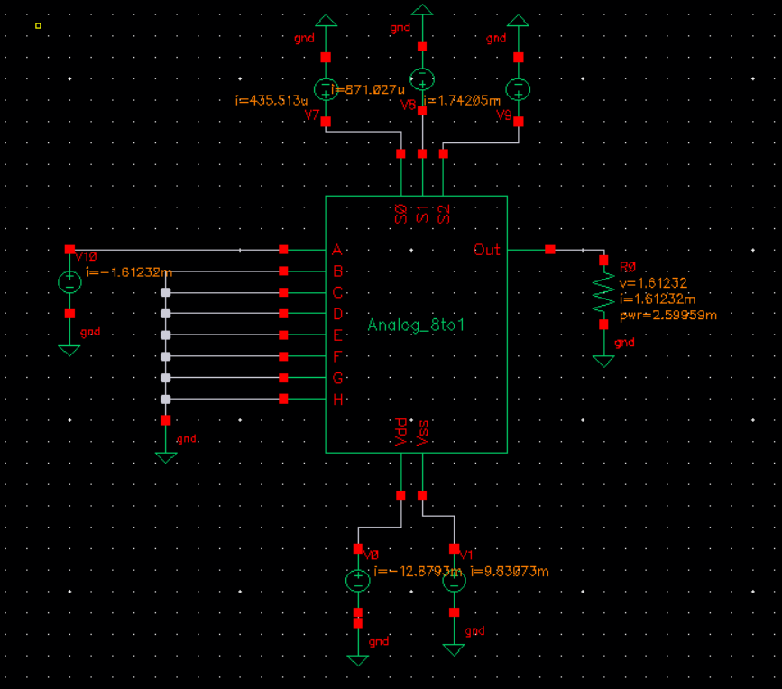
4.2 Specifications
4.2 Specifications
9. ON resistance (Required 10 ohm)
Circuit Setup
R_{ON} = (v_{out} - v_{in})/i_{out} = 209 ohm

Slide 27
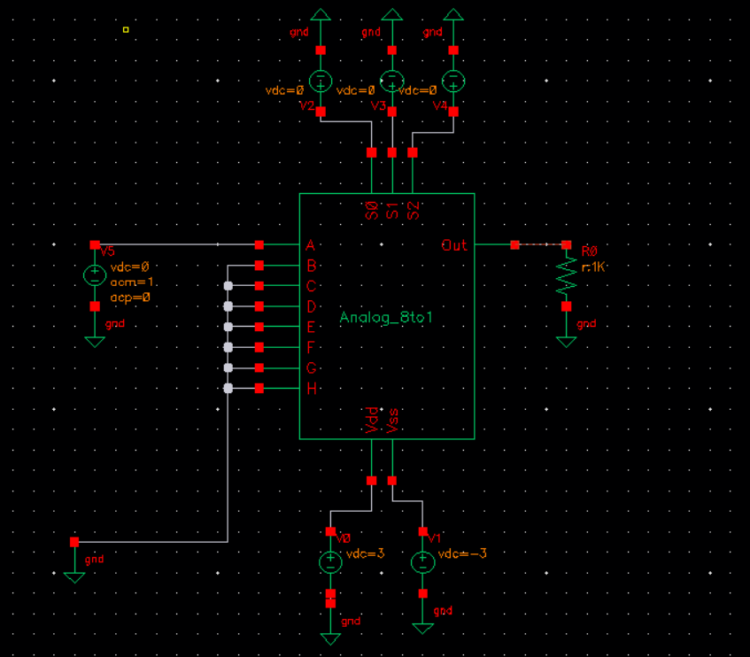
4.2 Specifications
4.2 Specifications
10. Bandwidth, -3dB (Required 1MHz)
Circuit Setup

Slide 28
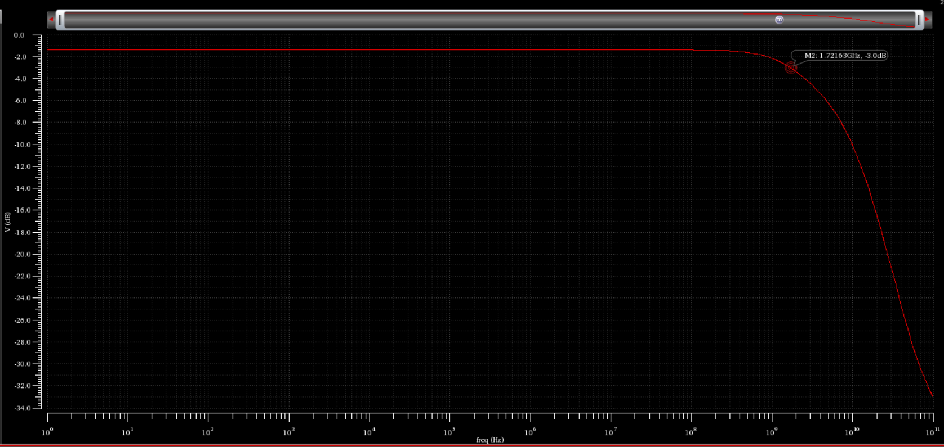
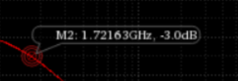
4.2 Specifications
4.2 Specifications
10. Bandwidth, -3dB (Required 1MHz)
Plot
The -3dB bandwidth is found 1.72 GHz.
This specification is met

Slide 29
4.2 Specifications
4.2 Specifications
Specification | Required | Calculated
Supply Voltage | +/-3 V | +/-3 V
Logic High Level | 1.4 V | 1.4V
Logic Low Level | 0 V | 0 V
Input Capacitance (max) | 50 pF | 14.68 pF
Charge injection over full signal swing range | 5 pC | -
Switching on Time t_{ON} | 100 ns | ~2 ns
Analog Signal Range | -2 to 2 | -2 to 2
Power Dissipation (max) | 10 mW | 4.47 mW
On Resistance | 10 ohm | 209 ohm
Bandwidth, -3dB | 1 MHz | 1.72 GHz

Slide 30
7. References
5 Rerference

